Slide 1

Module 1-Introduction to Big Data & Hadoop

Slide 2
Introduction to Big Data
From Week 0 – Lecture 1

Slide 3
Outline of the Week 0 session
Modules of the course
Course Objectives
Course Outcomes
Pre-req: Database and DWM
Traditional verses Big Data Solutions
Definition (not a standard one) of Big Data
Characteristics of Big Data (4/5 Vs)
Application areas

Slide 4
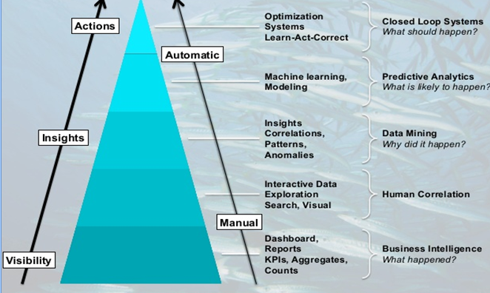
Why Big Data Mining???
Wisdom
Knowledge
Information
Data

Slide 5
Big Data Definition
Data sets that are too large and complex to manipulate or interrogate with standard methods or tools.
“Big Data” is data whose scale, diversity, and complexity require new architecture, techniques, algorithms, and analytics to manage and extract value and hidden knowledge from it.
Examples : Google, Yahoo, Facebook, eBay, Amazon …

Slide 6
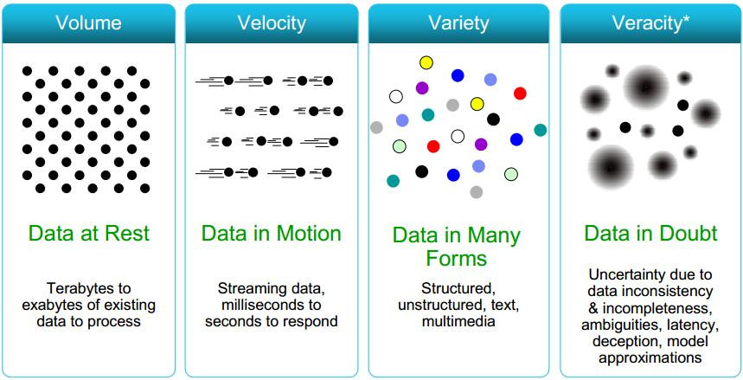
Big Data Characteristics (4Vs)

Slide 7
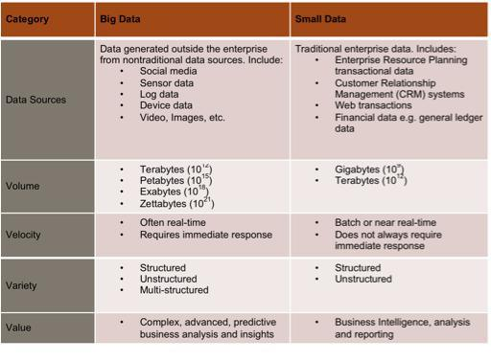

Slide 8

Notes:
Transactions are pretty simple to understand. This is our ERP data. It is the data that we maintain and track in our OLTP systems. It can be any record of any system-to-system or human-to-system interaction. It can even be a human-to-human interaction as long as it is captured electronically. We use a lot of this data in our analytics today.
Interactions are the points in time we relate with a system. It could be a tweet or a facebook post. It could be an electronic or paper customer satisfaction survey. Interactions are web logs and A/B tests. We have a lot of this data but typically no efficient way to understand or extract value from it.
Observations are interesting because they represent a world of net new data sources that we once never thought of analyzing. It is data that was once thought of as low to medium value data or even exhaust data that was too bulky and just too expensive to store. This can be machine-generated data from sensors or web logs and clickstreams or even audio/video or largely unstructured content. Typically, we never even thought of this data before.

Slide 9
Introduction to Hadoop
As introduced during Lab 1 Session

Slide 10
Core Components of HADOOP

Slide 11
Hadoop Core Component 1
HDFS
A file system designed to store large amounts of data across multiple nodes of commodity hardware.
HDFS has a master–slave architecture made up of data nodes which each store blocks of the data, retrieve data on demand, and report back to the name node with inventory.
The name node keeps records of this inventory (references to file locations and metadata) and directs traffic to the data nodes upon client requests.
This system has built-in fault tolerance, typically keeping three or more copies of each data block in case of disk failure.

Slide 12
High Level Hadoop Architecture

Slide 13
Hadoop Distributed File System

Slide 14
Hadoop Core Component 2
MapReduce Data processing engine:
A MapReduce job consists of two parts, a map phase, which takes raw data and organizes it into key/value pairs, and a reduce phase which processes data in parallel.
Hadoop MapReduce is a software framework for easily writing applications which process vast amounts of data in-parallel on large clusters ( thousands of nodes) of commodity hardware in a reliable, fault tolerant manner.

Slide 15
MapReduce (Hadoop’s computation engine)

Slide 16
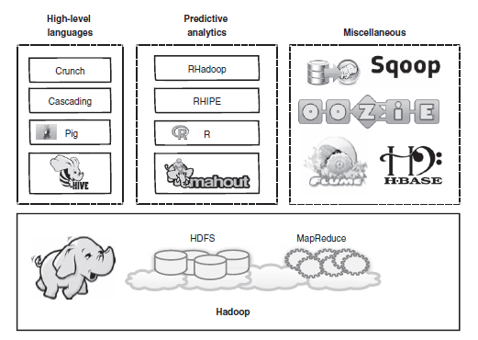
Core Components of Hadoop with other services

Slide 17
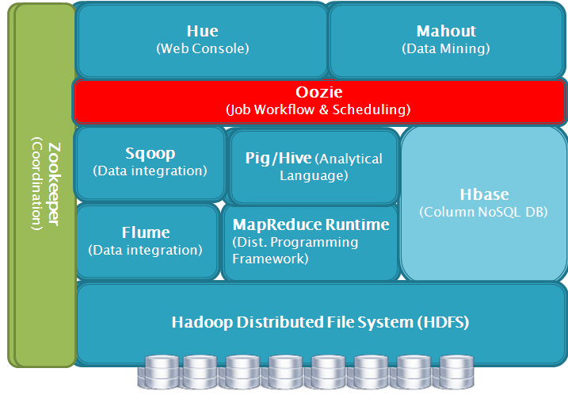
Hadoop Ecosystem
It is Apache’s open source software framework for storing, processing and analyzing big data.

Slide 18
Hadoop Ecosystem
Hive : It is SQL-like interface to Hadoop. It is an abstraction on top of MapReduce. allows users to query data in the Hadoop Cluster without knowing java or MapReduce. Uses HiveQL language very similar to SQL.
Pig : Pig is an alternative abstraction on top of MapReduce. It uses a dataflow scripting language called as PigLatin. The Pig interpreter runs on the client machine. Takes the PigLatin script and turns it into a series of MapReduce jobs and submits those jobs to the cluster.

Slide 19
Hadoop Ecosystem
HBase : HBase is "Hadoop Database" .It is 'NoSQL' data store. It can store massive amount of data e.g. Gigabyte, terabyte or even pet bytes of data in a table. MapReduce is not designed for iterative processes.
Flume : It is distributed real time data collection service. It efficiently collects, aggregate and move large amounts of data.
Sqoop : It provides a method to import data from tables in relational database into HDFS. It supports easy parallel database import/export. User can insert data from RDBMS to HDFS , Export data from HDFS to back into RDBMS.

Slide 20
Hadoop Ecosystem
Oozie - Oozie is workflow management project. Oozie allows developers to create a workflow of MapReduce jobs including dependencies between jobs. The Oozie server submits the jobs to the server in the correct sequence.
Hue : It is an open source web interface that supports Apache Hadoop and its ecosystem licensed under the Apache licence. Hue aggregates the most common Apache Hadoop components into a single interface and targets the user experience/UI Toolkit.

Slide 21
Hadoop Ecosystem
Mahout - It is machine learning tool. It supports distributed and scalable machine learning algorithms on the Hadoop Platform and helps in building intelligent applications easier and faster. It can provide distributed data mining function combined with Hadoop.
ZooKeeper : It is a centralized service for maintaining configuration information . It provides distributed synchronization. It contains a set of tools to build distributed applications that can safely handle partial failures. Zookeeper was designed to store coordination data, status information, configuration , location information about distributed application.

Slide 22
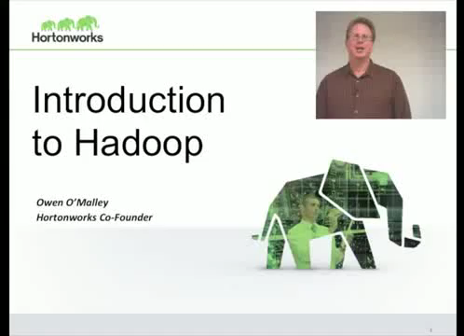

Slide 23
Module 2 – Hadoop HDFS and Map reduce
Beyond Hadoop Ecosystem…

Slide 24
Physical Architecture of Hadoop

Slide 25
MapReduce (Hadoop’s computation engine)

Slide 26
Schematic of Map Reduce computation

Slide 27
Map Reduce Overview
Sequentially read a lot of data
Map:
Extract something you care about
Group by key: Sort and Shuffle
Reduce:
Aggregate, summarize, filter or transform
Write the result

Slide 28
Map-Reduce
Programmer specifies:
Map and Reduce and input files
Workflow:
Read inputs as a set of key-value-pairs
Map transforms input kv-pairs into a new set of k'v'-pairs
Sorts & Shuffles the k'v'-pairs to output nodes
All k’v’-pairs with a given k’ are sent to the same reduce
Reduce processes all k'v'-pairs grouped by key into new k''v''-pairs
Write the resulting pairs to files
All phases are distributed with many tasks doing the work
Input 0
Input 1
Input 2
Map 0
Map 1
Map 2
Shuffle
Reduce 0
Reduce 1
Out 0
Out 1

Slide 29
Data Flow
Input and final output are stored on a distributed file system (FS):
Scheduler tries to schedule map tasks “close” to physical storage location of input data
Intermediate results are stored on local FS of Map and Reduce workers
Output is often input to another MapReduce task

Slide 30
Map Reduce: Step 1 – Map phase
Intermediate
key-value pairs
Input
key-value pairs
k
v
map
k
v
k
v
map
k
v
k
v
…
…
k
v
k
v

Slide 31
Map Reduce: Step 2 – Grouping and Reduce phase
Output
key-value pairs
Intermediate
key-value pairs
Key-value groups
reduce
k
v
k
v
v
v
k
v
Group
by key
reduce
k
v
k
v
v
k
v
k
v
…
…
…
k
v
k
v
k
v

Slide 32
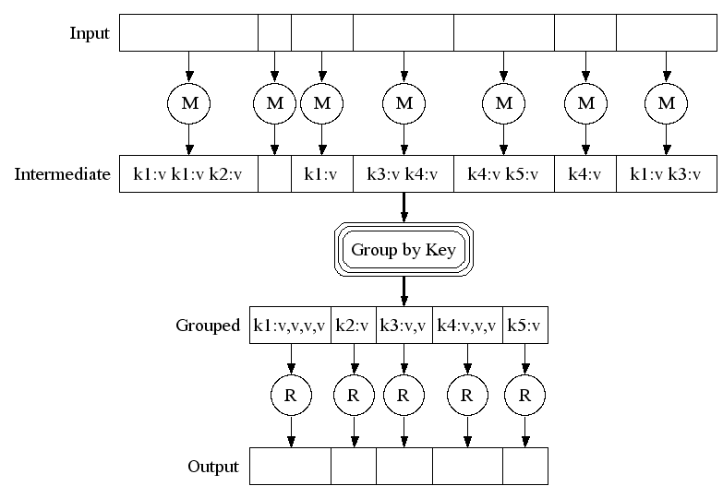
Map-Reduce: A diagram
Big document
MAP:
Read input and produces a set of key-value pairs
Group by key:
Collect all pairs with same key
(Hash merge, Shuffle, Sort, Partition)
Reduce:
Collect all values belonging to the key and output

Slide 33
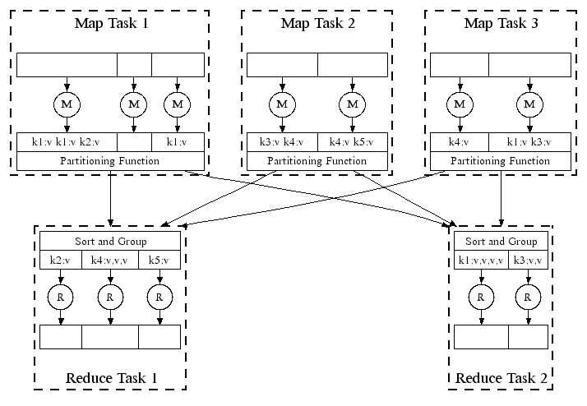
Map-Reduce: In Parallel
All phases are distributed with many tasks doing the work

Slide 34
Example: Word count using Map Reduce
map(key, value):
// key: document name; value: text of the document
for each word w in value:
emit(w, 1)
reduce(key, values):
// key: a word; value: an iterator over counts
result = 0
for each count v in values:
result += v
emit(key, result)

Slide 35
Working of Word Count
Provided by the programmer
Provided by the programmer
MAP:
Read input and produces a set of key-value pairs
Group by key:
Collect all pairs with same key
Reduce:
Collect all values belonging to the key and output
The crew of the space shuttle Endeavor recently returned to Earth as ambassadors, harbingers of a new era of space exploration. Scientists at NASA are saying that the recent assembly of the Dextre bot is the first step in a long-term space-based man/mache partnership. '"The work we're doing now -- the robotics we're doing -- is what we're going to need ……………………..
(The, 1)
(crew, 1)
(of, 1)
(the, 1)
(space, 1)
(shuttle, 1)
(Endeavor, 1)
(recently, 1)
….
(crew, 1)
(crew, 1)
(space, 1)
(the, 1)
(the, 1)
(the, 1)
(shuttle, 1)
(recently, 1)
…
(crew, 2)
(space, 1)
(the, 3)
(shuttle, 1)
(recently, 1)
…
Sequentially read the data
Only sequential reads
Big document
(key, value)
(key, value)
(key, value)

Slide 36
Refinement: Combiners
Often a Map task will produce many pairs of the form (k,v₁), (k,v₂), … for the same key k
E.g., popular words in the word count example
Can save network time by pre-aggregating values in the mapper:
combine(k, list(v₁)) → v₂
Combiner is usually same as the reduce function
Works only if reduce function is commutative and associative

Slide 37
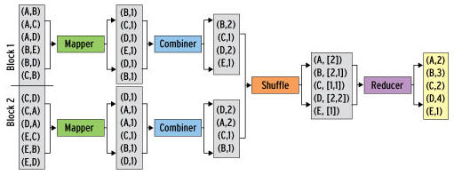
Refinement: Combiners - Example
Back to our word counting example:
Combiner combines the values of all keys of a single mapper (single machine):
Much less data needs to be copied and shuffled!

Slide 38
Quiz Time
https://forms.office.com/r/Qx2g003PR2
Link will be active on 30th July 2024 at 9:30 am. Duration for the quiz is 30 mins.

Slide 39
Thank You

